Slide 1
Sentiment-Driven Market Volatility Index:
A Big Data Approach to Financial Market Prediction
Aviral Bansal, Dev Pratap Singh, Darshan Sivarajah, Manit Garg,
Mohammad Yafi Akhtar, and Harsh Soni
Notes:
Everyone
Team Name: Sentiment-Driven Market Volatility. Read project title. Each team member should introduce themselves in order of what is on the screen - name, major

Slide 2

TABLE OF CONTENTS
01
04
02
05
03
06
Introduction
Methods
Data
Results
ICDS
Conclusion
Notes:
Manit

Slide 3

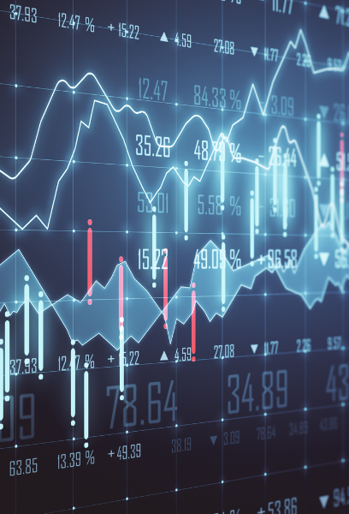
01
Introduction
Notes:
Harsh

Slide 4

Background
Traditional volatility models rely primarily on options pricing and historical activity
Doesn’t take into account sentiment-driven changes
News, social discourse, and general public opinion shapes the direction of the market
Data analytics enables us to to correlate public sentiment with market volatility
Aim: to create more comprehensive volatility prediction model
Notes:
Harsh
[largely from project proposal - consider rewriting]:
Financial markets exhibit complex dynamics driven by both quantitative metrics and qualitative factors, like investor sentiment. Traditional volatility models like VIX rely primarily on options pricing and historical price movements, potentially missing sentiment-driven market shifts that emerge from news cycles and social discourse. Recent advances in natural language processing and big data analytics enable us to consider recognize sentiment signals, as we can process vast amounts of unstructured text data. With this capability, we can attempt to correlate these sentiment patterns with market volatility to potentially identify early indicators of market movements and develop more comprehensive volatility prediction models.

Slide 5
Research Motivation
To develop a large-scale framework that creates a sentiment-driven volatility index that is potentially better than traditional volatility measures.
Notes:
Harsh
With this, we formally announce our research motivation. We want to develop a scalable PySpark-based framework that processes large-scale text data from multiple sources to create a sentiment-driven volatility index. It would ideally correlate with market performance, in which case we would be able to predict short-term market fluctuations better than traditional volatility measures.

Slide 6

02
Data
Notes:
Darshan

Slide 7
Data
Reddit
VIX Historical Data
Sentiment140
use API to extract posts from r/investing and r/stocks
also an existing, large dataset with posts from 14 relevant subreddits
21.7 GB
tracks performance of CBOE Volatility Index since the beginning of 1990
called the “fear index”
462 KB
contains 1,600,000 tweets extracted using Twitter API
annotated; 0 = negative, 4 = positive
238.8 MB
NewsAPI
StockData.org
Yahoo Finance
extracts articles from major news outlets’
contains article headlines
timestamp for publishing time
identifies source of news
375 KB
extracts info from major news outlets’ articles
contains article headlines
timestamp for publishing time
4.9 MB
extensive details for stock performances
Total data size:
29.94 GB
Notes:
Darshan
We had a lot of trouble acquiring the data because using free API keys give us limited data. Even running it consistently for weeks, we struggled to acquire Gigabytes-worth of data. As a result, we turned to using already-existing datasets to make up the difference between what we had and our target. Ultimately, we ended up with 29.94 Gigabytes of data.
The first of these data sets is a Reddit dataset. It pulls from 14 relevant subreddits, including r/wallstreetbets, r/personalfinance, and r/financialindependence. It is by far our largest, coming up to 21.7 GB. It also pulls from r/investing and r/stocks, which we also collected data from using the Reddit API.
Our second source called Sentiment140, which contains a whopping 1.6 million tweets, readily annotated as having positive or negative sentiment.
Next, we have historical data for the VIX volatility index. VIX, often called the "fear index", measures the stock market's expectation of 30-day forward-looking volatility, A higher VIX indicates greater expected price swings and investor uncertainty, while a lower VIX suggests a more stable market. Even though VIX was introduced in 1993, it can be calculated back to 1990, which is where our dataset begins.
We used APIs to pull from StockData.org and NewsAPI too. Both sources extract headlines from articles published from major news outlets, with timestamps.
Lastly, we used Y Finance to obtain extensive data related to stock performances. We joined it to our other combined datasets to grow the features to include information about market performance

Slide 8

Processing
First, we processed sentiment140:
filtered out rows with missing headlines and/or scores
split the strings into a list of tokens
converted these token into a vector
used IDF to reweight the importance of the words
Next, we processed VIX historical data
filtered out the close and date columns, as that is all that we would need
converted the date into a format that we could use
inner joined this data set with the previous one, using date as our common column
Lastly, we collected all the headlines into a parquet directory for Spark to use
Notes:
Yafi
For our Sentiment140 dataset, we began by removing rows with missing headlines or scores. Next, we split the strings into a list of tokens, so that each word was its own token, and converted them into a vector. IDF was then used to reweight the importance of the words. For our VIX data, we removed unnecessary columns and converted the data into a format that is easier to handle. After that, we performed an inner join with the Sentiment140 dataset with the data as the common column. Lastly, we collected all the headlines into a parquet directory for Spark to use.

Slide 9
03
ICDS
Notes:
Manit

Slide 10

Using ICDS
Infeasible to process our data on local device
30 GB of data
Too computationally expensive
Hardware can not handle it
ICDS Roar Collab is an appropriate tool
Greater processing power
Resource utilization
Parallel processing
Scalable
Notes:
Manit
It is infeasible to process our data on local devices because of its immense size. It would be too computationally great.
Being a supercomputer, it has much more processing power than any of the other devices or tools that our group has access to. To handle such a large dataset, ICDS is exactly what we need. It also has more efficient resource utilization, since CPU, memory and storage needs can be dynamically shared amongst multiple nodes. Parallel processing also helps with efficiency.
In our research motivation section, we mentioned scalability, and ICDS helps with that too. As our dataset grows, we can elicit the help of more nodes to ensure that it doesn’t take significantly more time to run.
We upload scp command to upload code to the ICDS platform and sbatch to run in. There isn’t much more to it.

Slide 11

04
Methods
Notes:
Dev and Aviral

Slide 12
Methods
01
04
02
03
Choosing Model
Evaluating
Creating Pipeline
Training
Notes:
Dev
There are many models that we have learned to use in this class and in other classes, so we had discussions about what we should apply to the problem that we chose. There were a few that we quickly ruled out, like linear regression and multiple linear regression, because they would be too rudimentary for what we would try to do. Logistic regression was another one we chose not to use because it simple wouldn’t work for stocks. However, we did you it in the sentiment model. We did throw around the idea of XGBoost because it is robust and can handle large datasets well. That method is known to have high precision and accuracy and can capture complex relationships. However, ultimately, we chose to use time series because this approach was practically built to solve questions like the one we had - it identifies trends temporal trends and can be applied well to real-time data.

Slide 13
05
Results
Notes:
Aviral

Slide 14
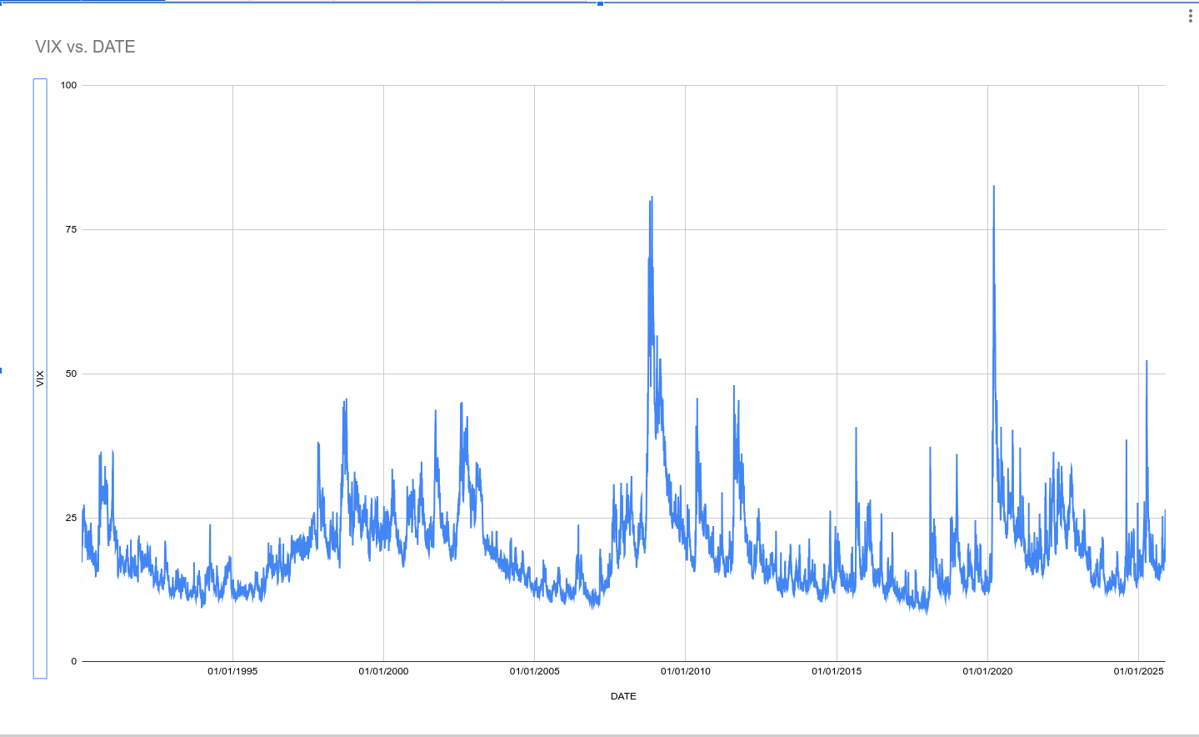
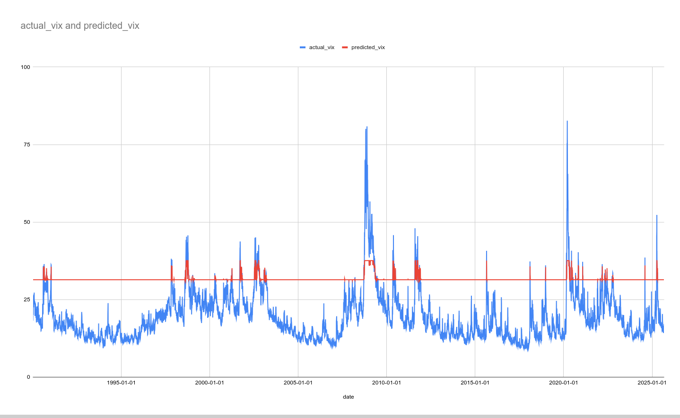
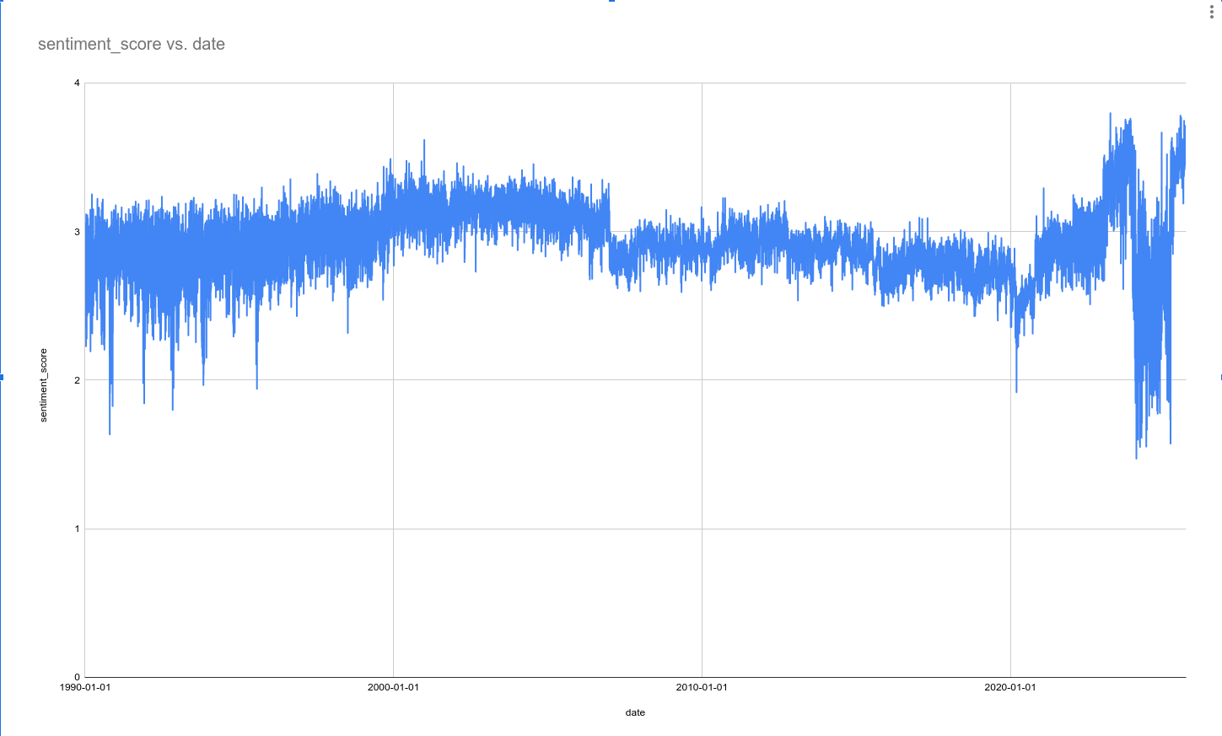
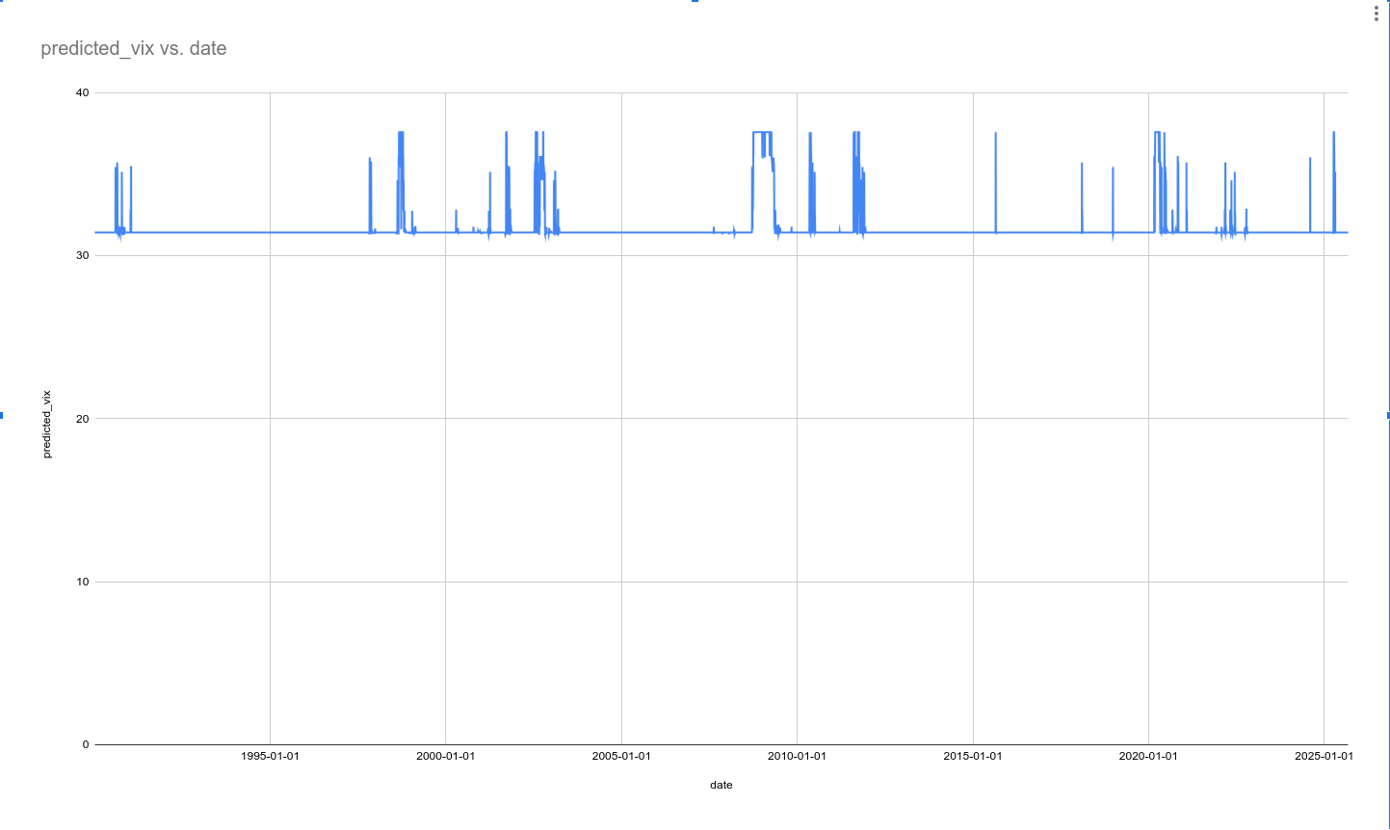
Results
Notes:
Aviral
1.vix vs date
2. Actual vs predicted vix
3. Sentiment score vs date
4. Predicted_vix vs date
Mae - 2.25
RMSE-2.719

Slide 15

06
Conclusion
Notes:
Yafi

Slide 16
Conclusion
Our model’s predicted stock prices were about 2 points away from the actual stock prices for the day, corresponding to roughly 10% average error.
This shows the model can capture the general trend reasonably well, but there is still room to reduce prediction error and improve accuracy.
For this project, we handled data collection and preprocessing, then built and evaluated prediction models using stock data and APIs, with shared work on modeling and predictions.
Notes:
Yafi
Darshan’s contribution: collecting data for StockData.org and NewsAPI, and then wrote code to process API data. He was in-charge of making the slides.
Harsh’s contribution: writing the report

Slide 17
Thank You for Your Attention
Notes:
Thank you for listening to our presentation. We hope that you found our project interesting.

Slide 18
Links to our presentation
Part 1:- https://psu.mediaspace.kaltura.com/media/Sentiment-Driven%20Market%20Volatility%20Index%20Part%201/1_xxnxefy8
Part 2:- https://psu.mediaspace.kaltura.com/media/Sentiment-Driven+Market+Volatility+Index+Part+2/1_49v5eb3c

